Slide 1

Where are the Best Irish Bars in NYC?

Slide 2
Overview
New York City
One of the most multi-cultural and diverse cities in the world
Over 65m tourists in 2018
Main attractions include Statue of Liberty, Times Square and Central Park
Nightlife attractions include theatres, sports events and nightclubs/bars
Irish Bars have the best “craic”
Where are the best Irish Bars in NYC?

Slide 3
Data Sources
Data source: https://cocl.us/new_york_dataset
This data set contains the longitude and latitude of each borough and neighborhood in New York City. This information will be used to explore the various neighborhoods in each borough.
2. Data source : https://data.cityofnewyork.us/City-Government/Borough-Boundaries/tqmj-j8zm
This data set will enable us to visualise New York City Borough boundaries.
3. Data source : FourSquare API
This API will provide us a summary of the Irish bars in each borough and neighborhood across New York City.

Slide 4
Methodology / Approach
Pull in the New York City borough and neighborhood from the data source: https://cocl.us/new_york_dataset.
Use the FourSquare API to identify all venues in each borough and neighborhood.
Identify the venues which are Irish Bars.
Use the FourSquare API to find the average rating and tips for each Irish Bar.
Using the data, identify the Irish Bars based on an average rating greater than 7.
Produce a map of New York City that visualizes the location of the Irish Bars in each neighborhood.

Slide 5
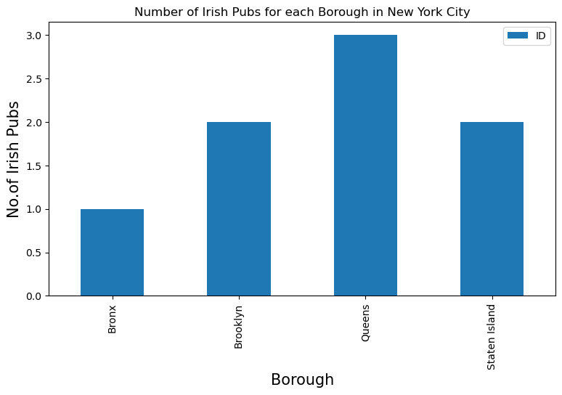
Discussion – Results and Limitations
306 neighborhoods in NYC
Only 7 Irish Bars (seems much too low – Four Square data limitation)
Most Irish Bars in the borough of Queens

Slide 6
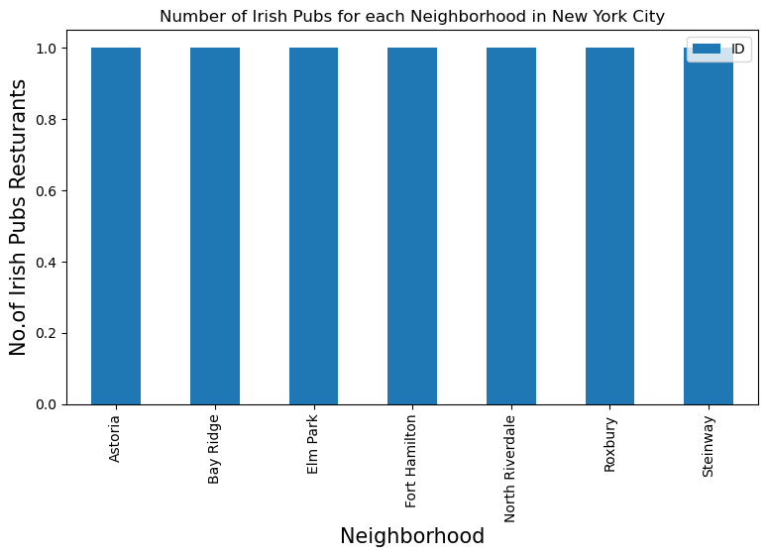
Discussion – Results and Limitations
Only one Irish Bar in each neighborhood

Slide 7
Discussion – Results and Limitations
Table below shows the neighborhood with the best Irish Bars with an average rating >7.
The two highest rated bars are in Queens.
Borough | Neighborhood | Avg Rating
Queens | Astoria | 8.1
Brooklyn | Bay Ridge | 7.6
Staten Island | Elm Park | 7.0
Brooklyn | Fort Hamilton | 7.6
Queens | Steinway | 9.0
Staten Island | Westerleigh | 7.0

Slide 8

Conclusion
If visiting NYC, make your way to Queens for the best Irish Bars!

